Slide 1



Slide 2
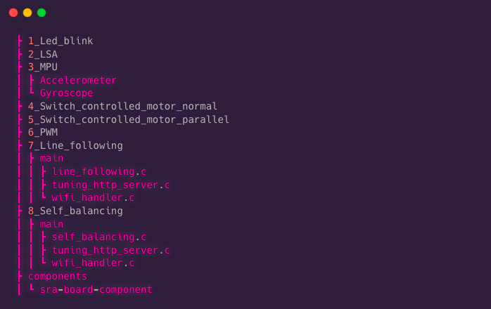
Wall-E Code Structure

Slide 3
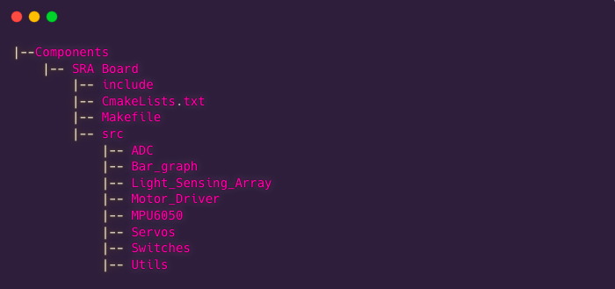
Components

Slide 4
How to create a test file??
1. Go to esp/esp-idf/examples/get-started folder
2. Make a new folder named 'test'
3. Now go to esp/esp-idf/examples/get-started/blink
4. Copy the contents of that Folder (main, CMakeLists… everything except the build folder)
5. Paste the contents inside your test folder
6. In your test folder open the CMakeLists file and change 'blink' to 'test' and save and close that file
7. Then in your test folder go inside main folder and open the CMakeLists file
8. Change 'blink.c' to 'test.c' and save and close that file
9. Now in your main folder Rename the blink.c file as test.c
10. Then you can change the test.c file and code in that
Make changes which you think are necessary, don't change any header statements if possible.

Slide 5
How to run a test file you have created??
1. In terminal go to esp/esp-idf/codes/test
(Folder you just created)
2. sudo chmod 777 /dev/ttyUSB0 # Not for Windows
3. Then enter your password if asked
4. idf.py -p /dev/ttyUSB0 -b 2000000 flash
5. If you have written any printf statements in the code to see the results
idf.py monitor
(ctrl ]) to stop the monitor
Make sure your esp is connected to laptop while doing all these.

Slide 6
Building the Project
idf.py build # Command for building the code
This command is the same for all the Operating Systems.
This command builds and compiles all the files inside the folder.
This is similar to the gcc command written in C to compile our code.

Slide 7
Flashing the Code
After running the build command, we flash the newly built binaries on the ESP-32.
This is done via the following command:
idf.py -p PORT [-b BAUD] flash
Here, PORT stands for the Serial Port number of the ESP-32, and BAUD stands for the Baud Rate(rate of information transfer to the ESP-32)
Example Ports:
For Linux: /dev/ttyUSB0
For MacOS: /dev/cu.usbserial-0001
For Windows: /COM1#/2/3/…..

Slide 8
Flashing the Code
Checking Ports
Type the below commands in your terminal according to the system you have:
For Linux: dmesg | grep tty
For MacOS: /dev/cu.*
For Windows:
Open the Device Manager. Connect and disconnect the ESP-32 and observe which port appears and disappears. That will be your port number (e.g. COM0 or COM3)

Slide 9
Monitoring the Output from ESP-32
ESP-IDF also has a tool to monitor the output of the ESP-32.
The IDF monitor tool is a serial terminal program which relays serial data to and from the target device’s serial port.
We can achieve this by going into the project directory via the terminal and giving the command:
idf.py monitor

